Slide 1
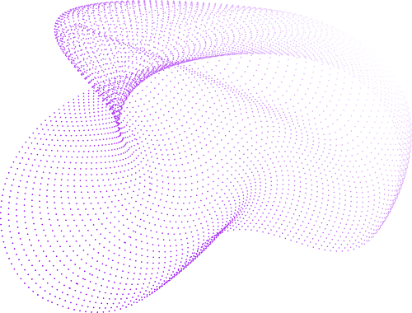
19ELC202
Object Oriented Programming (OOPS) Project
Transformer tap changing module

Slide 2
Agenda
Overview
Implementation
Modules used
Contributions

Slide 3

Overview
Briefly describes what the following slides will be about.
BACK TO AGENDA PAGE

Slide 4
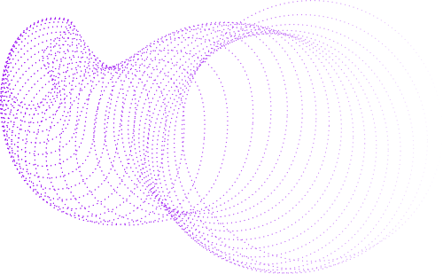
Overview
The project on "Tap Changer Mechanism of Transformers using Object-Oriented Programming (OOP)" aims to explore an innovative approach to managing voltage regulation in transformers.
Transformers play a vital role in power distribution, and maintaining stable voltage levels is crucial for their efficient operation.
This project delves into the application of Object-Oriented Programming principles to simulate and control the tap changer mechanism within transformers.
By implementing OOP concepts such as encapsulation, inheritance, and polymorphism, we aim to create a robust and flexible system for managing voltage variations in transformers.

Slide 5
This initiative focuses on designing and modeling transformer and tap changer classes using OOP, allowing for the seamless adjustment of voltage levels.
Through the implementation of these classes and their interactions, we intend to showcase a simulated environment that accurately reflects the behavior of tap changers in regulating voltage.
The use of OOP enables us to encapsulate data, enhance abstraction, and potentially explore different types of tap changer mechanisms for various transformer configurations.

Slide 6
The primary objective is not just to simulate voltage regulation but to demonstrate the effectiveness and advantages of applying OOP in managing critical functionalities within the field of electrical engineering.
This project aims to highlight the potential for scalable and maintainable solutions through OOP while addressing the crucial aspect of voltage stability in transformers.
This presentation will delve into the design and implementation aspects of our project, showcasing the code, simulation, and the benefits of employing an OOP approach in managing the tap changer mechanism of transformers.

Slide 7
Implementation
BACK TO AGENDA PAGE

Slide 8
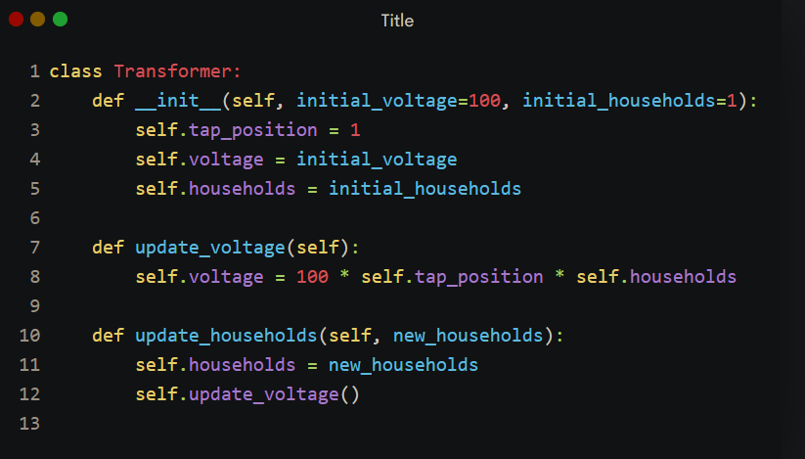
Transformer Class

Slide 9
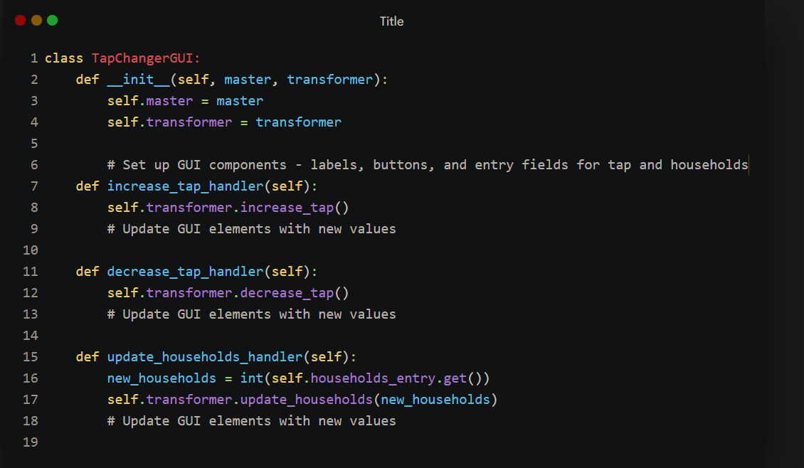
Tapchanger Graphical User Interface (GUI)

Slide 10
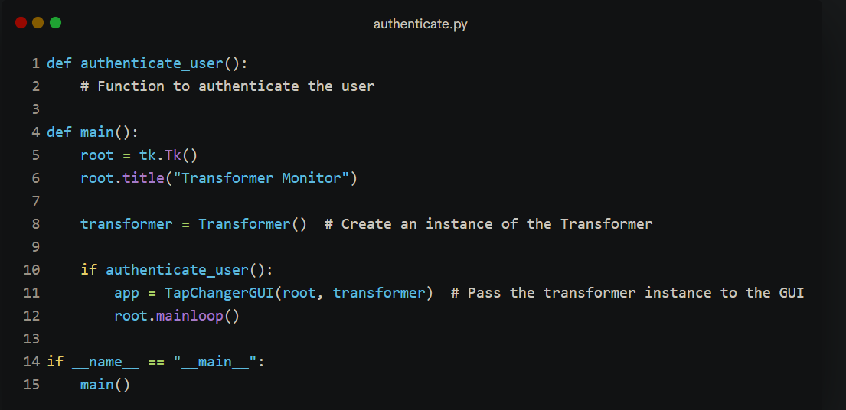
Authentication

Slide 11
Real-life tap changing

Slide 12
Modules Used
BACK TO AGENDA PAGE

Slide 13
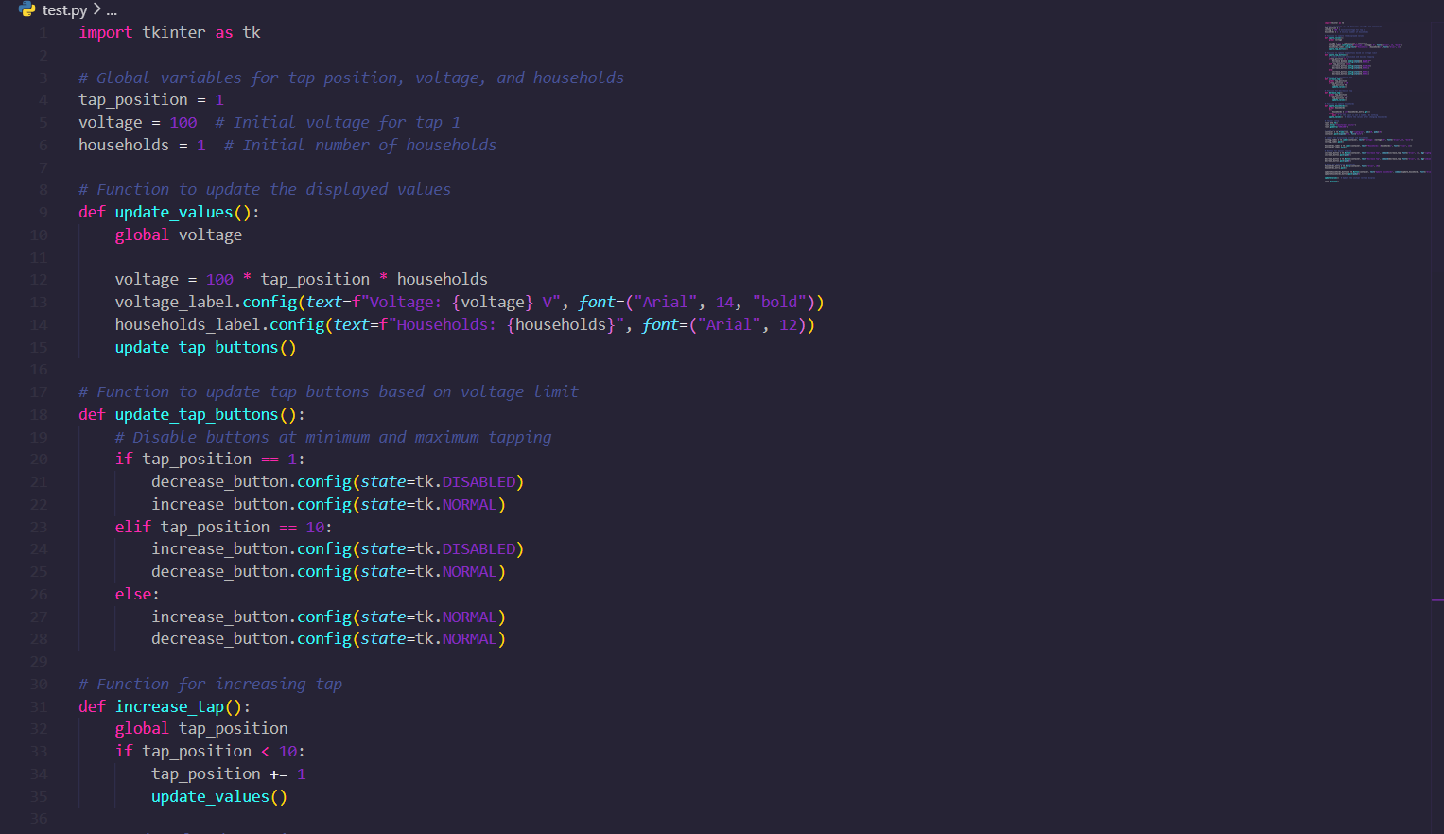
To display tabulation
Modules Used
Tabulate
Modules Used
tkinter
requests
datetime
Matplotlib
For graphs
BACK TO AGENDA PAGE

Slide 14
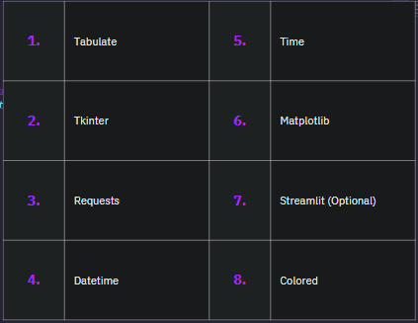
Modules
Used
1. | Tabulate | 5. | Time
2. | Tkinter | 6. | Matplotlib
3. | Requests | 7. | Streamlit (Optional)
4. | Datetime | 8. | Colored
Packages installed using Python
Package Installer (pip)

Slide 15
Contributions
Our Hardwork poured with our time in it🕐
BACK TO AGENDA PAGE

Slide 16

Contributions
Meshak Immanuvel A
CB.EN.U4ELC22027
Nivedhitha G
CB.EN.U4ELC22036
Suren Karthik B J
CB.EN.U4ELC22051
Pranav Karthikeyan
CB.EN.U4ELC22062

Slide 17
Contributions
Meet our verbal master who had explained about the working principle of a transformer and what it does. He had also explained how tap changing occurs in the transformer.
Meshak Immanuvel A
CB.EN.U4ELC22027

Slide 18
Contributions
Meet our design expert who had poured her time in designing the user interface(UI) with all her knowledge and skills and had also explained how the transformer tapping can be done with the help of OOPS.
Nivedhitha G
CB.EN.U4ELC22036

Slide 19
Contributions
Meet our think-tank who had contributed the overall idea and had also explained the conclusion that were discussed and mentioned in the previously shown slides
Suren Karthik B J
CB.EN.U4ELC22051

Slide 20
Contributions
Meet our master coder who had poured his time into developing the program and logical ideas on how the program works with all his skills. He had also explained the modules that are used in the program.
Pranav Karthikeyan
CB.EN.U4ELC22062

Slide 21

BACK TO AGENDA PAGE
Geeks for Geeks
geeksforgeeks.com
Pypi Manager
pypi.org
Thank You
Programiz
programiz.com

